Slide 1
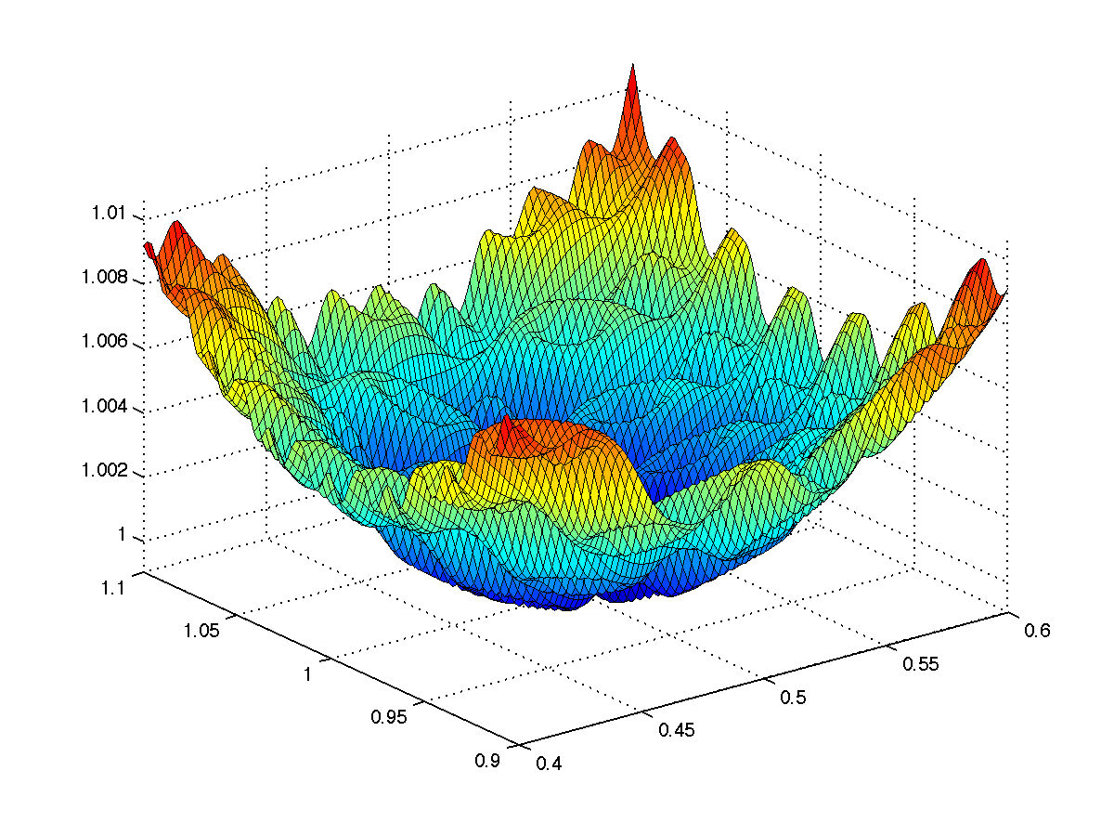
CS 5/7320 Artificial Intelligence Local Search AIMA Chapters 4.1 & 4.2
Slides by Michael Hahsler based on slides by Svetlana Lazepnik with figures from the AIMA textbook.
This work is licensed under a Creative Commons Attribution-ShareAlike 4.0 International License.

Slide 2
Contents
What is Local Search?
Hill-Climbing Search
Simulated Annealing
Evolutionary Algorithms
Search in Continuous Spaces

Slide 3

Recap: Uninformed and Informed Search
Tries to plan the
best path
from a
given initial state
to a
given goal state.
Often comes with optimality guarantees (BFS, A* Search, IDS).
Typically searches a large portion of the search space (needs time and memory).
Initial state
Goal state

Slide 4
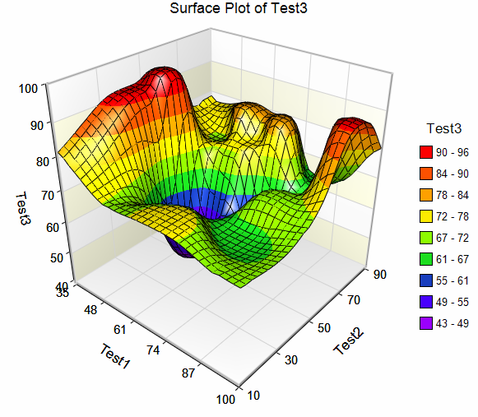
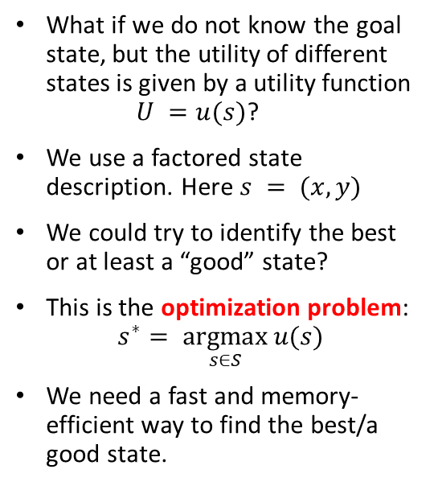
Local Search Algorithms
Local move from state to state
What if we do not know the goal state, but the utility of different states is given by a utility function $U =u(s)$?
We use a factored state description. Here $s = (x, y)$
We could try to identify the best or at least a “good” state?
This is the optimization problem: $s^{∗}= \underset{s∈S}{argmax}{u(s)}$
We need a fast and memory-efficient way to find the best/a good state.
x
x
Utility U
y
x
Idea:
Start with a current solution (a state) and improve the solution by moving from the current state to a “neighboring” better state (a.k.a. performing a series of local moves).

Slide 5
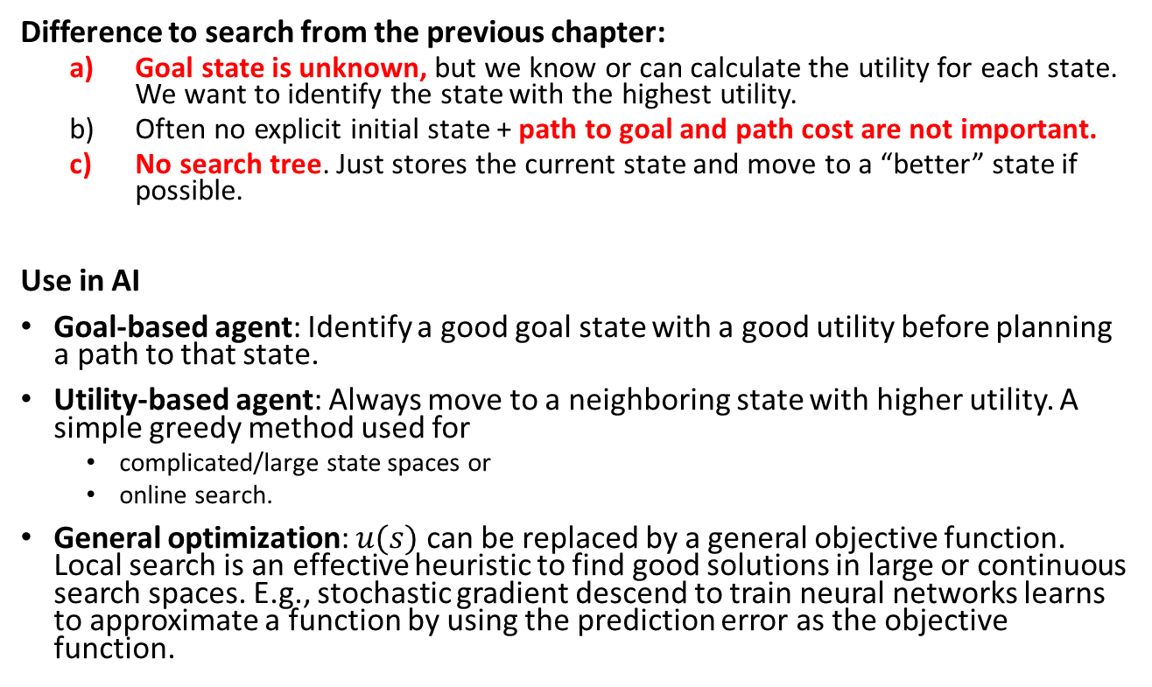
Local Search Algorithms
Difference to search from the previous chapter:
Goal state is unknown, but we know or can calculate the utility for each state. We want to identify the state with the highest utility.
Often no explicit initial state + path to goal and path cost are not important.
No search tree. Just stores the current state and move to a “better” state if possible.
Use in AI
Goal-based agent: Identify a good goal state with a good utility before planning a path to that state.
Utility-based agent: Always move to a neighboring state with higher utility. A simple greedy method used for
complicated/large state spaces or
online search.
General optimization: $u(s)$ can be replaced by a general objective function. Local search is an effective heuristic to find good solutions in large or continuous search spaces. E.g., stochastic gradient descend to train neural networks learns to approximate a function by using the prediction error as the objective function.

Slide 6



Example: n-Queens Problem
states
Goal: Put n queens on an n × n board with no two queens on the same row, column, or diagonal.
Defining the search problem:
State space: All possible n-queen configurations. How many are there?
State representation: How do we define a factored representation?
Objective function: What is a possible utility function given the state representation?
Local neighborhood: What states are close to each other?

Slide 7
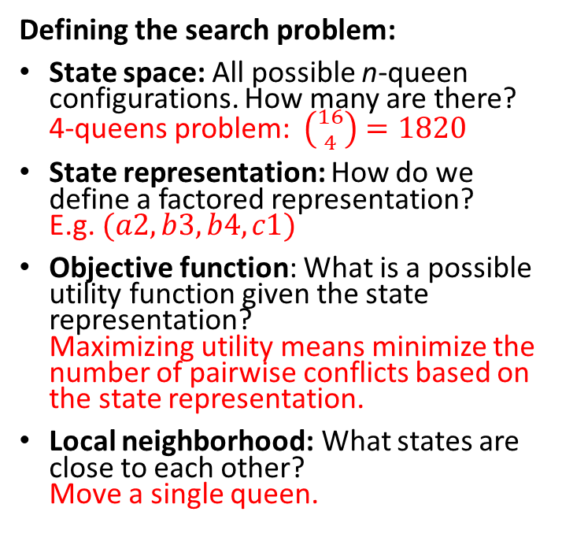
Example: n-Queens Problem
2 conflicts = utility of -2
4
3
2
1
Defining the search problem:
State space: All possible n-queen configurations. How many are there? 4-queens problem: $\left({16 \atop 4}\right)=1820$
State representation: How do we define a factored representation? E.g. $(a2, b3, b4, c1)$
Objective function: What is a possible utility function given the state representation? Maximizing utility means minimize the number of pairwise conflicts based on the state representation.
Local neighborhood: What states are close to each other? Move a single queen.
a b c d
Has its optimum at the goal state. Similar to a heuristic in A* search.
0 conflicts = utility of 0
Defines a transition function.

Slide 8
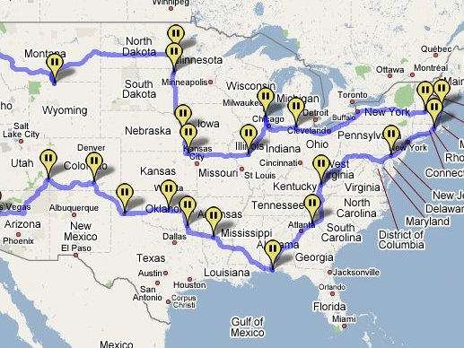
Example: Traveling salesman problem
Goal: Find the shortest tour connecting a given set of cities
State space: all possible tours (states are not individual cities!)
State representation: Order of cities in the tour.
Objective function: minimize the length of the tour.
Local neighborhood: Change the order of visiting a few cities.
Note: We have solved a different problem with uninformed/informed search! Each city was defined as a state and the path was the solution.

Slide 9

Hill-Climbing Search aka Greedy Local Search
Idea: keep a single “current” state and try to find better neighboring states.
MotorCycleUSA.com

Slide 10
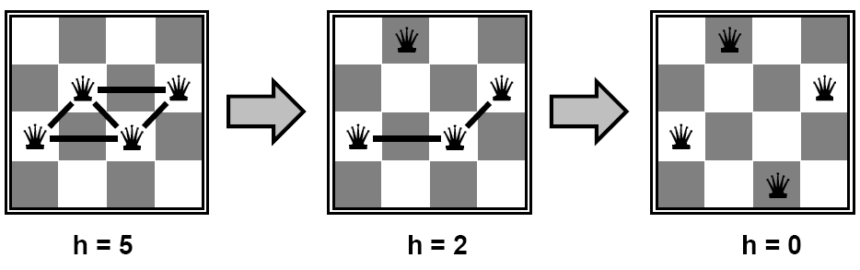
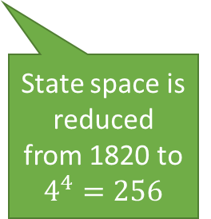
Example: n-Queens Problem
Goal: Put n queens on an n × n board with no two queens on the same row, column, or diagonal. State space: all possible n-queen configurations. We can restrict the state space: Only one queen per column.
State representation: row position of each queen in its column (e.g., 2, 3, 2, 3)
Objective function: minimize the number of pairwise conflicts.
Local neighborhood: Move one queen anywhere in its column.
Improvement strategy
Find a local neighboring state (move one queen within its column) to reduce conflicts
State space is reduced from 1820 to $4^{4}=256$
4
3
2
1

Slide 11
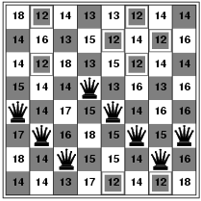
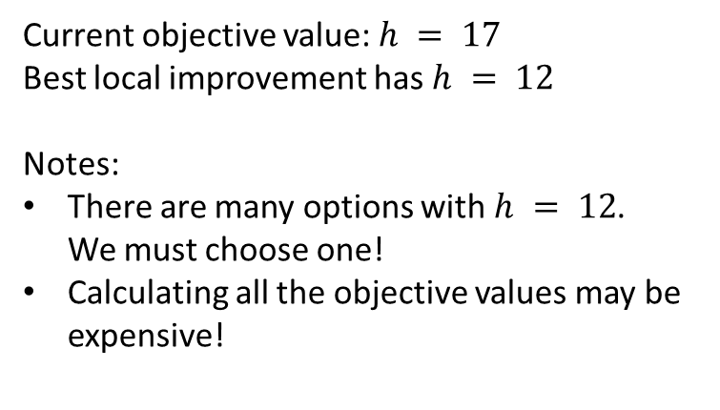
Example: n-Queens Problem
To find the best local move, we must evaluate all local neighbors (moving a single queen in its column while leaving the others in place) and calculate the objective function.
Objective value after moving the queen in column 1 to this square
Current objective value: $h = 17$
Best local improvement has $h = 12$ Notes:
There are many options with $h = 12$. We must choose one!
Calculating all the objective values may be expensive!

Slide 12
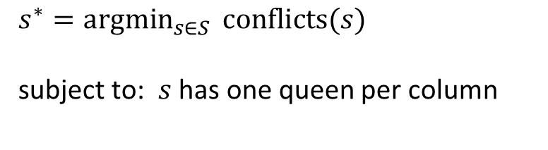
Example: n-Queens Problem
Formulation as an optimization problem: Find the best state $s^{∗}$ representing an arrangement of queens.
$$s^{∗}={argmin}_{s∈S } conflicts(s)$$ subject to: $s$ has one queen per column
Remember: This makes the problem a lot easier.

Slide 13

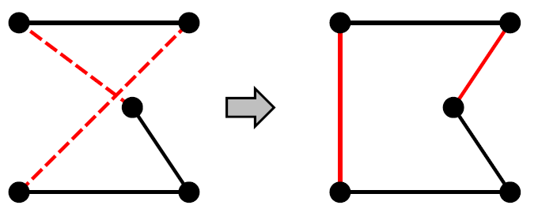
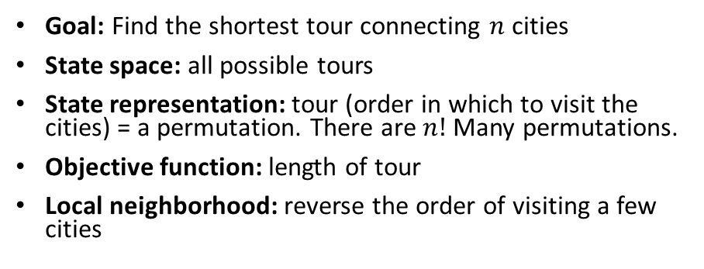
Example: Traveling Salesman Problem
Goal: Find the shortest tour connecting $n$ cities
State space: all possible tours
State representation: tour (order in which to visit the cities) = a permutation. There are $n!$ Many permutations.
Objective function: length of tour
Local neighborhood: reverse the order of visiting a few cities
Local move to reverse the order of cities C, E and D:
A
B
A
B
C
C
D
E
D
E
State representation (permutation):
ABDEC
ABCED

Slide 14
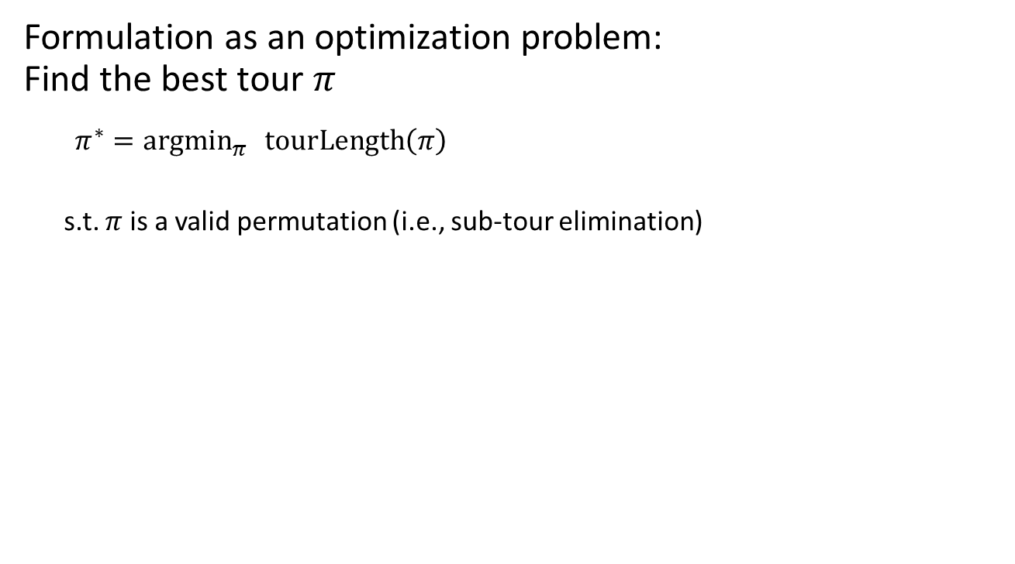
Example: Traveling Salesman Problem
Formulation as an optimization problem: Find the best tour $π$
${π^{∗}=argmin}_{π } tourLength\left(π\right)$
s.t. $π$ is a valid permutation (i.e., sub-tour elimination)
Local move to reverse the order of cities C, E and D:
A
B
A
B
C
C
D
E
D
E
State representation:
ABDEC
ABCED

Slide 15
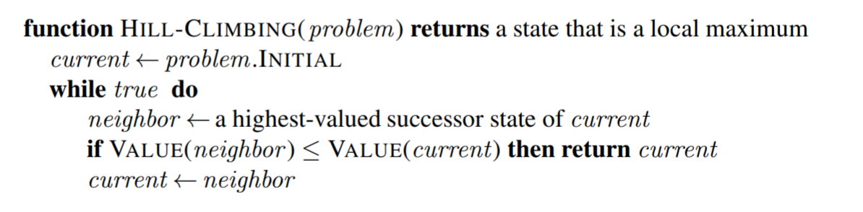

Hill-Climbing Search (Greedy Local Search)
Maximization
We often start with a random state
Use $≥$for minimization
Variants:
Steepest-ascend hill climbing
Check all possible successors and choose the highest-valued successors.
Stochastic hill climbing
Choose randomly among all uphill (improvement) moves, or
generate randomly one new successor at a time and only move to better ones = first-choice hill climbing – the most popular variant, this is what people often mean when they say “stochastic hill climbing”
Minimization

Slide 16
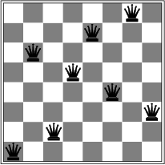
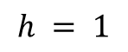
Local Optima
Hill-climbing search is like greedy best-first search with the objective function as a (maybe not admissible) heuristic and no frontier (just stops in a dead end).
Is it complete/optimal?
No – can get stuck in local optima
Example: local optimum for the 8-queens problem. No single queen can be moved within its column to improve the objective function.
$$h = 1$$
Simple approach that can help with local optima:
Random-restart hill climbing: Restart hill-climbing many times with random initial states and return the best solution. This strategy can be used for any stochastic (i.e., randomized) algorithm.

Slide 17
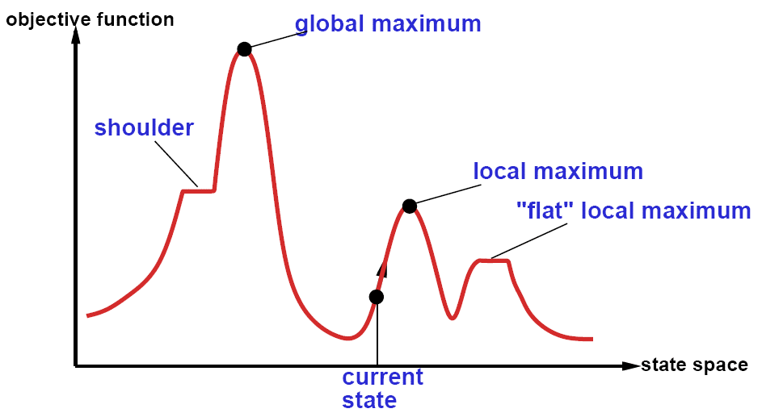

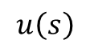
The State Space “Landscape”
We can get the utility (objective function value) from the state description using $u\left(s\right).$
Maximization
$$u\left(s\right)$$
$$s$$
Neighbors placed next to each other
How to escape local maxima?
→ Random restart hill-climbing can help.
What about “shoulders” (called “ridges” in higher dimensional space)?
→ Hill-climbing that allows sideways moves and uses momentum.

Slide 18
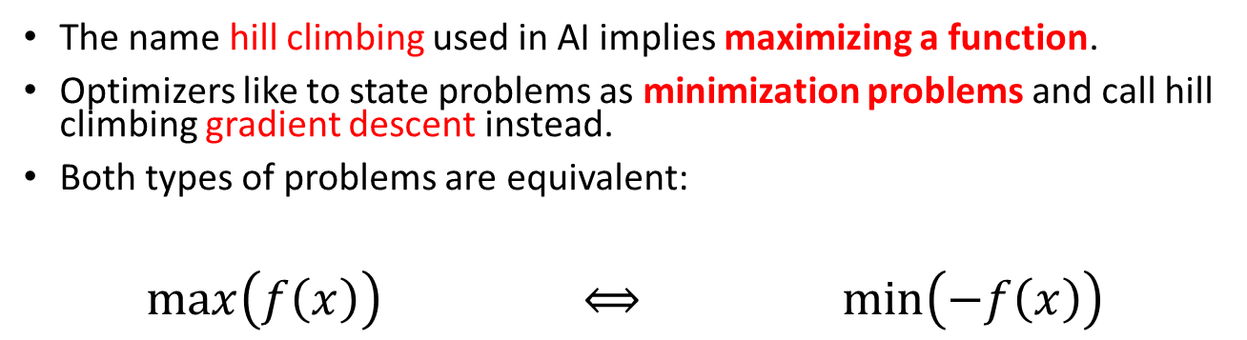
Minimization vs. Maximization
The name hill climbing used in AI implies maximizing a function.
Optimizers like to state problems as minimization problems and call hill climbing gradient descent instead.
Both types of problems are equivalent:
$\max\left(f\left(x\right)\right)$ $⟺$ $\min\left(−f\left(x\right)\right)$

Slide 19
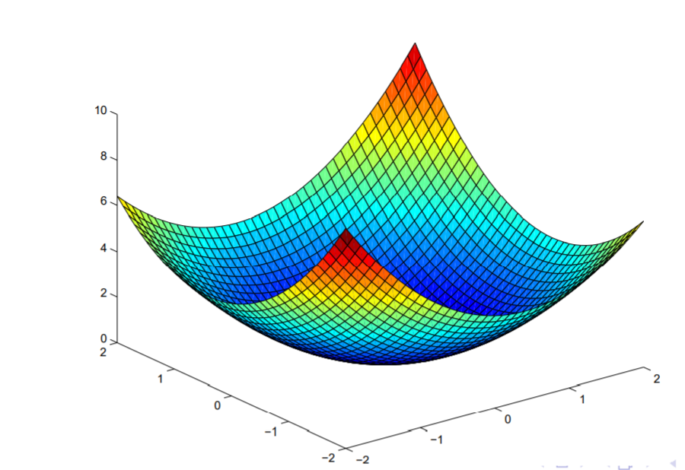
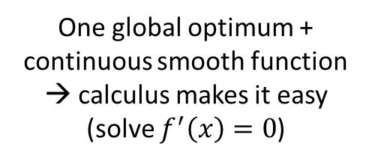
Convex vs. Non-Convex Optimization Problems
Minimization
Convex Problem
Non-convex Problem
One global optimum + continuous smooth function → calculus makes it easy (solve $f^{′}\left(x\right)=0$)
Many local optima → hard
Many AI problems are in addition discrete (the objective function is not differentiable). We often have to settle for a local optimum.

Slide 20
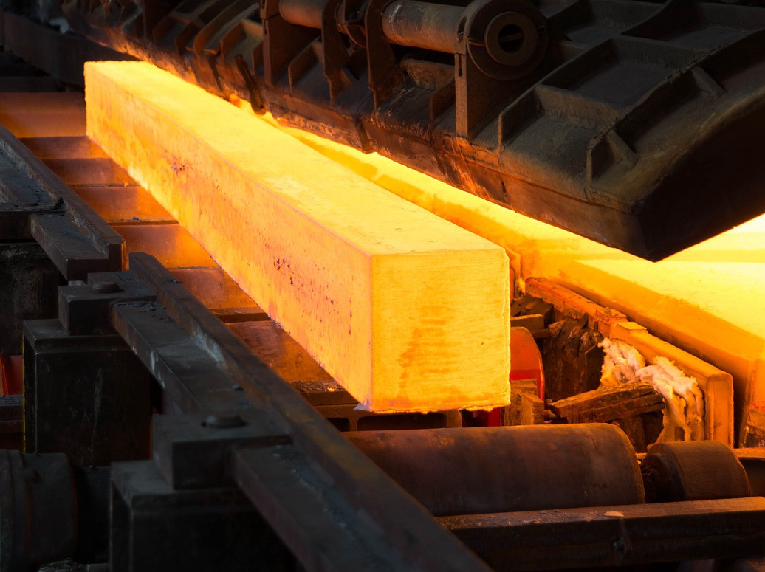
Simulated Annealing
Use heat to escape local optima…

Slide 21
Simulated Annealing
Idea: First-choice stochastic hill climbing + escape local minima by allowing some “bad” moves but gradually decrease their frequency.
Inspired by the process of controlled cooling of glass or metals by decreasing the temperature (here chance of accepting bad moves) gradually.
Minimization
“bad” local move
Objective function
State space

Slide 22
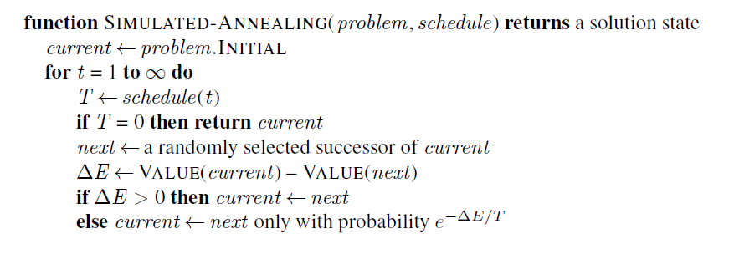
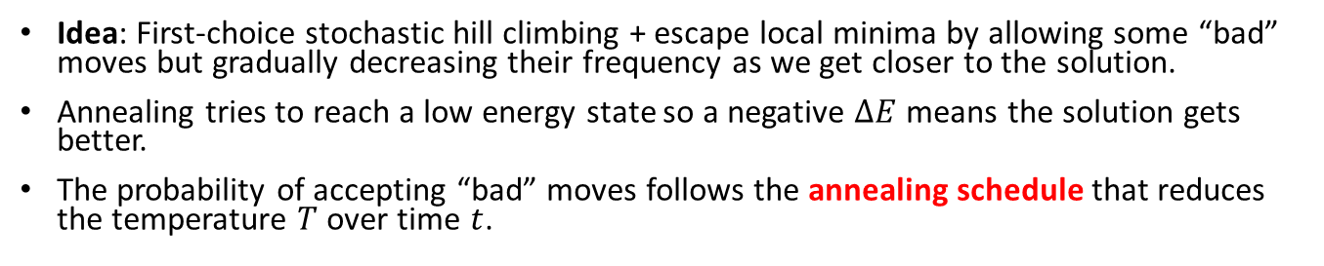
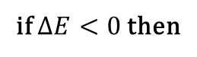
Simulated Annealing
Idea: First-choice stochastic hill climbing + escape local minima by allowing some “bad” moves but gradually decreasing their frequency as we get closer to the solution.
Annealing tries to reach a low energy state so a negative $ΔE$ means the solution gets better.
The probability of accepting “bad” moves follows the annealing schedule that reduces the temperature $T$ over time $t$.
Maximization
Typically, we start with a random state
Always accept good moves that reduce the energy.
Accept “bad” moves with a probability inspired by the acceptance criterion in the Metropolis–Hastings MCMC algorithm.
if $ΔE<0$ then
Note: Use $VALUE(next) – VALUE(current)$for minimization

Slide 23
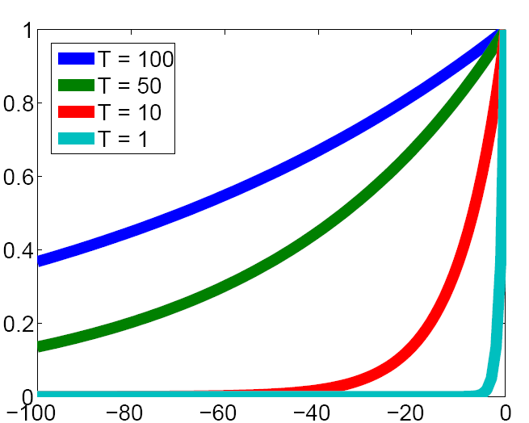
The Effect of Temperature
Convert the changes due to “bad” moves into an acceptance probability depending on the temperature. The criterion uses the negative part of the exponential function.
Prob. of accepting a worse state exp(-ΔE/T)
-ΔE (neg. means the solution gets worse)

Slide 24
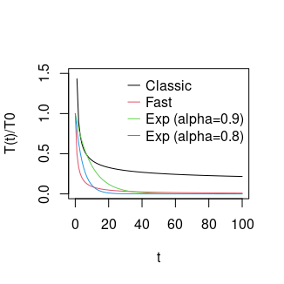
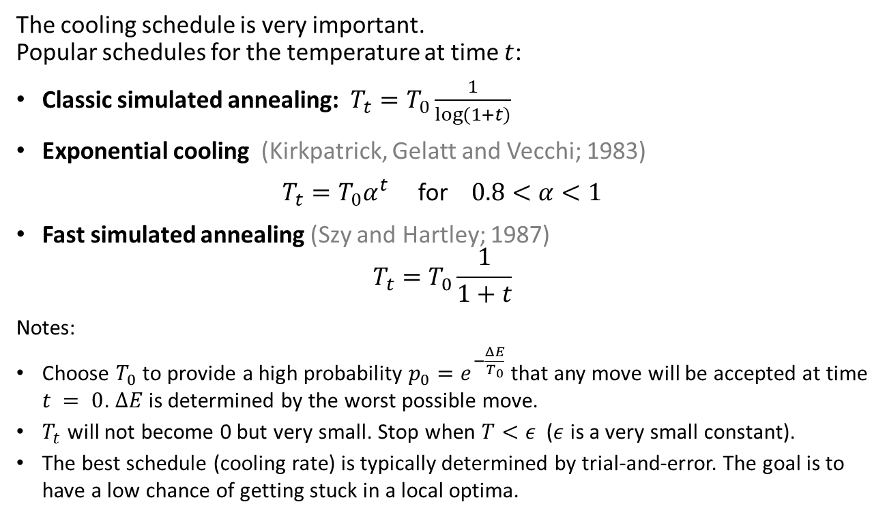
Cooling Schedule
The cooling schedule is very important. Popular schedules for the temperature at time $t$:
Classic simulated annealing: $T_{t}=T_{0}\frac{1}{log⁡(1+t)}$
Exponential cooling (Kirkpatrick, Gelatt and Vecchi; 1983)
$T_{t}=T_{0}α^{t}$ for $0.8<α<1$
Fast simulated annealing (Szy and Hartley; 1987)
$$T_{t}=T_{0}\frac{1}{1+t}$$
Notes:
Choose $T_{0}$ to provide a high probability $p_{0}=e^{−\frac{ΔE}{T_{0}}}$that any move will be accepted at time $t = 0$. $ΔE$is determined by the worst possible move.
$T_{t}$ will not become 0 but very small. Stop when $T<ε$ ($ε$ is a very small constant).
The best schedule (cooling rate) is typically determined by trial-and-error. The goal is to have a low chance of getting stuck in a local optima.

Slide 25
Simulated Annealing Search
Guarantee: If the temperature is decreased slowly enough, then simulated annealing search will find a global optimum with a probability approaching one.
However:
This usually takes impractically long.
We need to experiment with the cooling schedule to find one that typically avoids local optima.

Slide 26
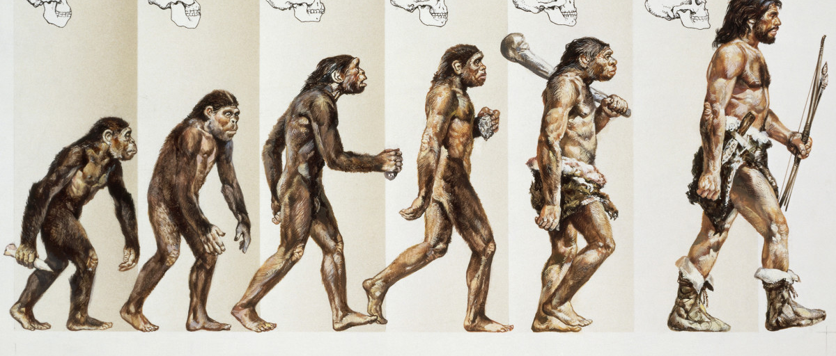
Evolutionary Algorithms
A Population-based Metaheuristics

Slide 27
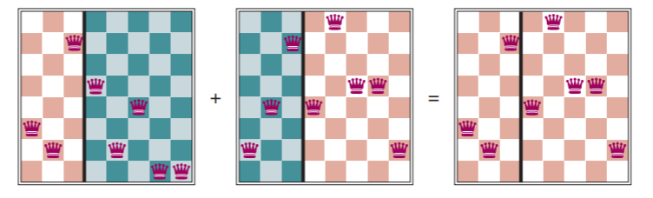
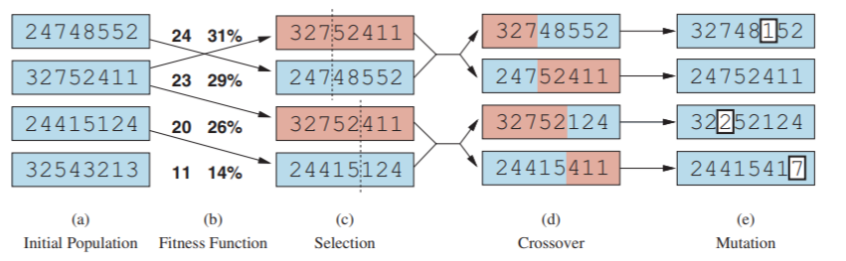
Evolutionary Algorithms / Genetic Algorithms
A metaheuristic for population-based optimization.
Uses mechanisms inspired by biological evolution (genetics):
Reproduction: Random selection with probability based on a fitness function.
Random recombination (crossover)
Random mutation
Repeated for many generations
Example: 8-queens problem
8
7
6
5
4
3
2
1
Individual = state representation as a chromosome: row of the queen in each column
next generation

Slide 28
Search in Continuous Spaces

Slide 29


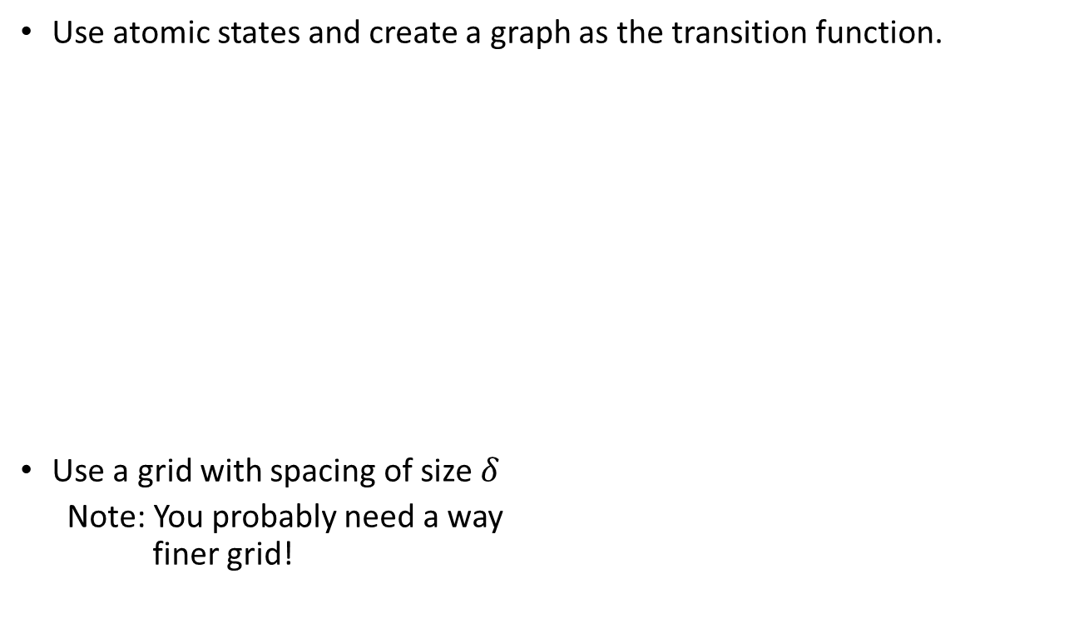
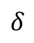
Discretization of Continuous Space
Use atomic states and create a graph as the transition function.
Use a grid with spacing of size $δ$
Note: You probably need a way finer grid!
$$δ$$
y
x

Slide 30
Discretization of Continuous Space
How did we discretize this space?
Initial state
Goal state
Discretization grid

Slide 31
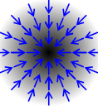
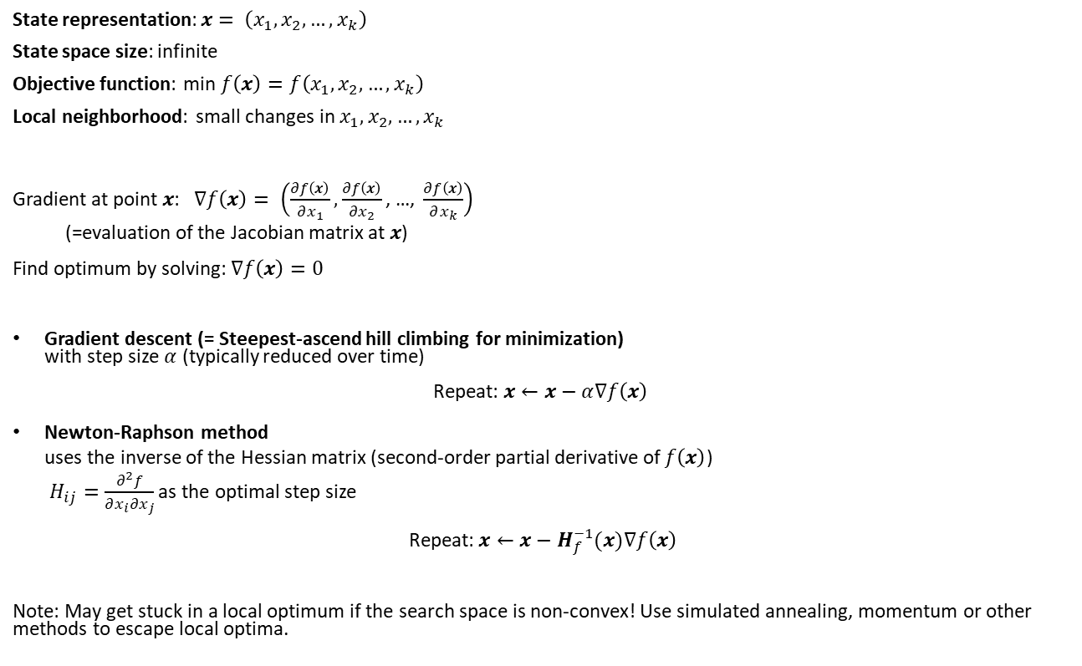
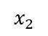
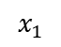
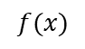
Search in Continuous Spaces: Gradient Descent
$$f(x)$$
State representation: $x= \left(x_{1},x_{2},…,x_{k}\right)$
State space size: infinite
Objective function: min $f\left(x\right)=f\left(x_{1},x_{2},…,x_{k}\right)$
Local neighborhood: small changes in $x_{1},x_{2},…,x_{k}$
Gradient at point $x$: $∇f\left(x\right)= \left(\frac{∂f\left(x\right)}{∂x_{1}}, \frac{∂f\left(x\right)}{∂x_{2}}\text{, …, }\frac{∂f\left(x\right)}{∂x_{k}}\right)$ (=evaluation of the Jacobian matrix at $x$)
Find optimum by solving: $∇f\left(x\right)=0$
Gradient descent (= Steepest-ascend hill climbing for minimization) with step size $α$ (typically reduced over time)
Repeat: $x←x−α∇f\left(x\right)$
Newton-Raphson method uses the inverse of the Hessian matrix (second-order partial derivative of $f\left(x\right)$) $H_{ij}=\frac{∂^{2}f}{∂x_{i}∂x_{j}}$ as the optimal step size
Repeat: $x←x−H_{f}^{−1}(x)∇f\left(x\right)$
Note: May get stuck in a local optimum if the search space is non-convex! Use simulated annealing, momentum or other methods to escape local optima.
$$x_{1}$$
$$x_{2}$$

Slide 32
Search in Continuous Spaces: Stochastic Gradient Descent
What if the mathematical formulation of the objective function is not known?
We may have objective values at fixed points, called the training data.
In this case, we can perform gradient descent with an approximation of the gradient using the data points. This is called stochastic gradient descent (SGD).
→ We will talk more about search in continuous spaces with loss functions using gradient descend when we talk about parameter learning for learning from examples (machine learning).

Slide 33

Conclusion
Local search provides a fast method to find good solutions to many difficult optimization problems.
Local optima are a big issue that can be addressed with random restarts and simulated annealing.

